Slide 1


‘18.08.22 송석정
DL
Object Detection

Slide 2
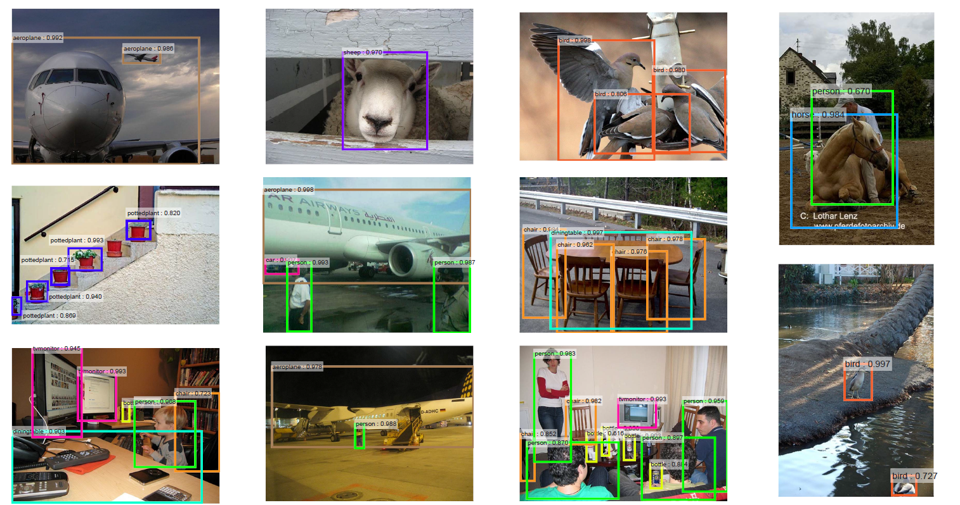
Image Detection?
주어진 image에 존재하는 object를 찾아 label과 bounding box를 출력

Slide 3
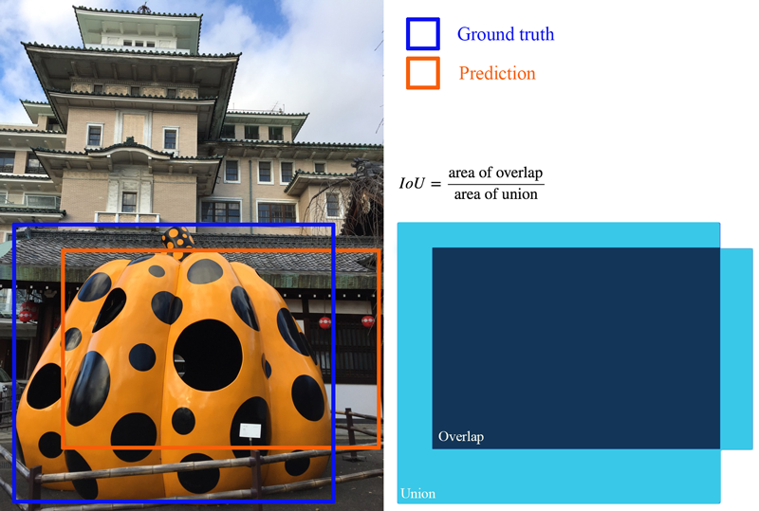
Intersection over Union (IoU)
IoU measures how much overlap between 2 regions, This measures how good is our prediction in the object detector with the ground truth (the real object boundary).

Slide 4
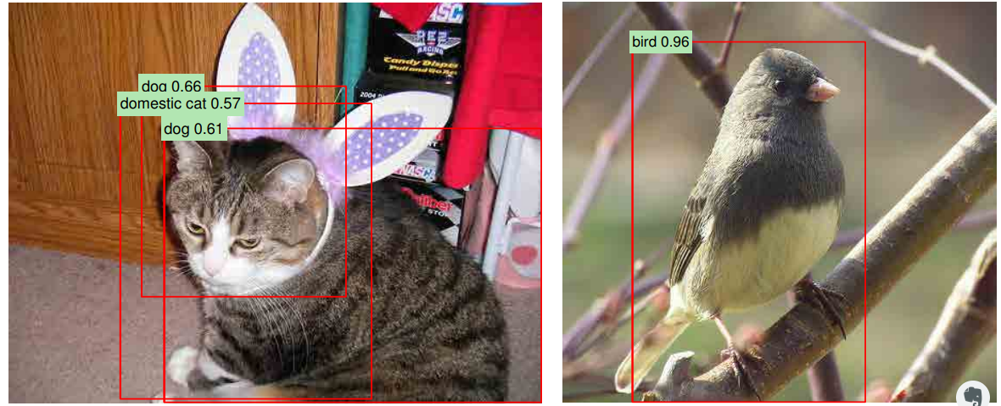
Confidence level

Slide 5
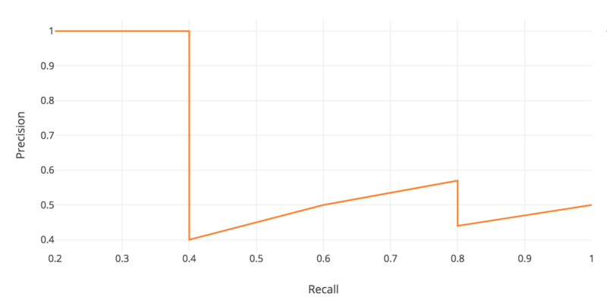
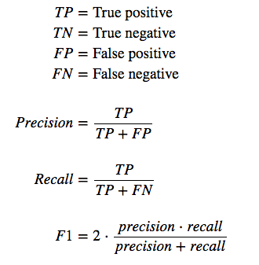
mean Average Precision (mAP)
Object detection 의 평가 기준
It is the average of the maximum precisions at different recall values.
Precision measures how accurate is your predictions.
i.e. the percentage of your positive predictions are correct.
Recall measures how good you find all the positives.
For example, we can find 80% of the possible positive cases in our top K predictions.

Slide 6
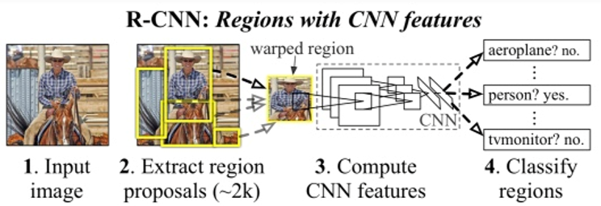
https://arxiv.org/pdf/1311.2524.pdf
1. Region with CNN (R-CNN)
Region proposal
Region warping
SVM

Slide 7
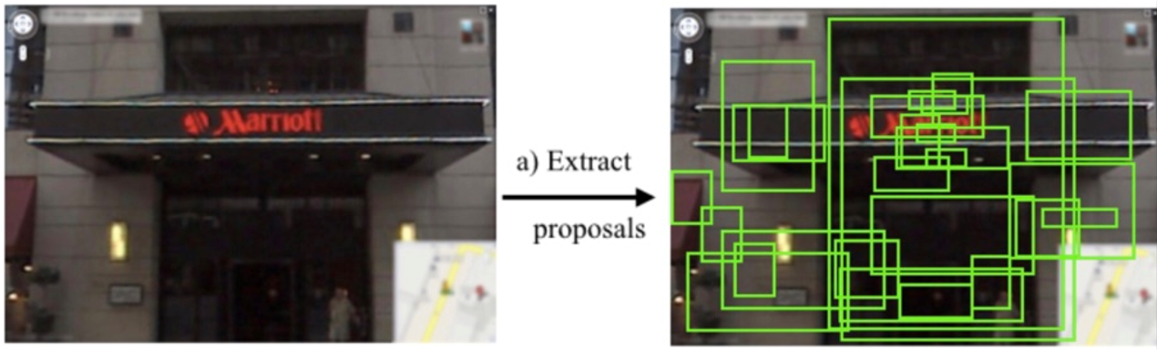
RCNN
Region proposals
학습하지 않고, Selective Search 라는 알고리즘 사용
색상이나 강도, 패턴 등이 비슷한 인접한 픽셀을 한 region으로 묶는 방식
한 이미지당 약 2000개의 region 추출

Slide 8
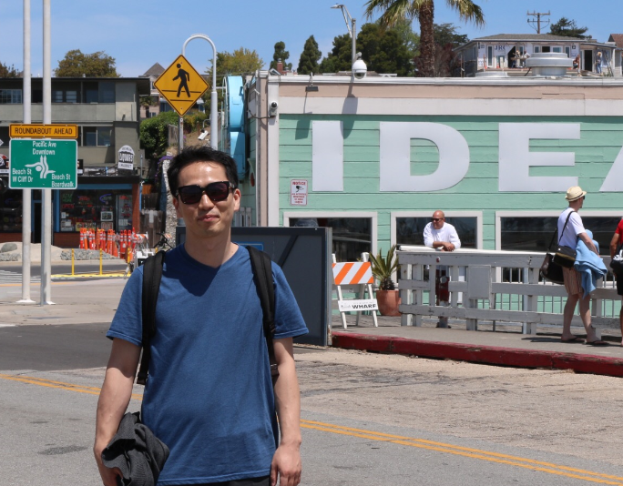
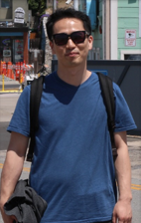
RCNN
CNN
AlexNet 사용
AlexNet
Crop & reshape
227 x 227
4096 features
SVM
20 + 1 classes

Slide 9
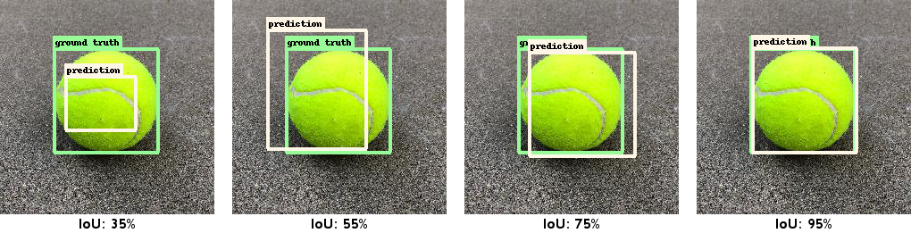
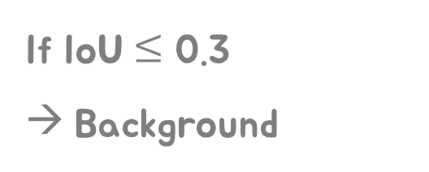
RCNN
Training
Pre-training : ILSVRC2012 data
Domain-specific fine-tuning : warped region
If IoU $≤$ 0.3
→ Background

Slide 10
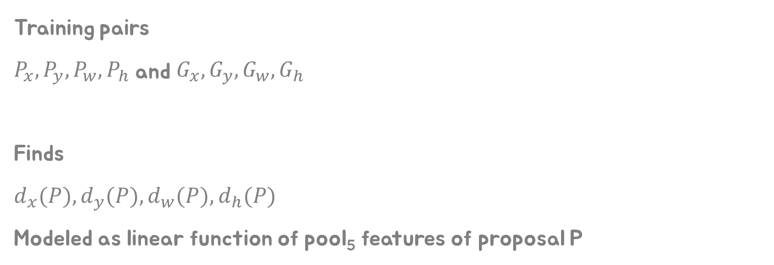
RCNN
Bounding box regression
Training pairs
$P_{x},P_{y},P_{w},P_{h}$ and $G_{x},G_{y},G_{w},G_{h}$
Finds
$d_{x}(P),d_{y}(P),d_{w}(P),d_{h}(P)$
Modeled as linear function of pool₅ features of proposal P

Slide 11
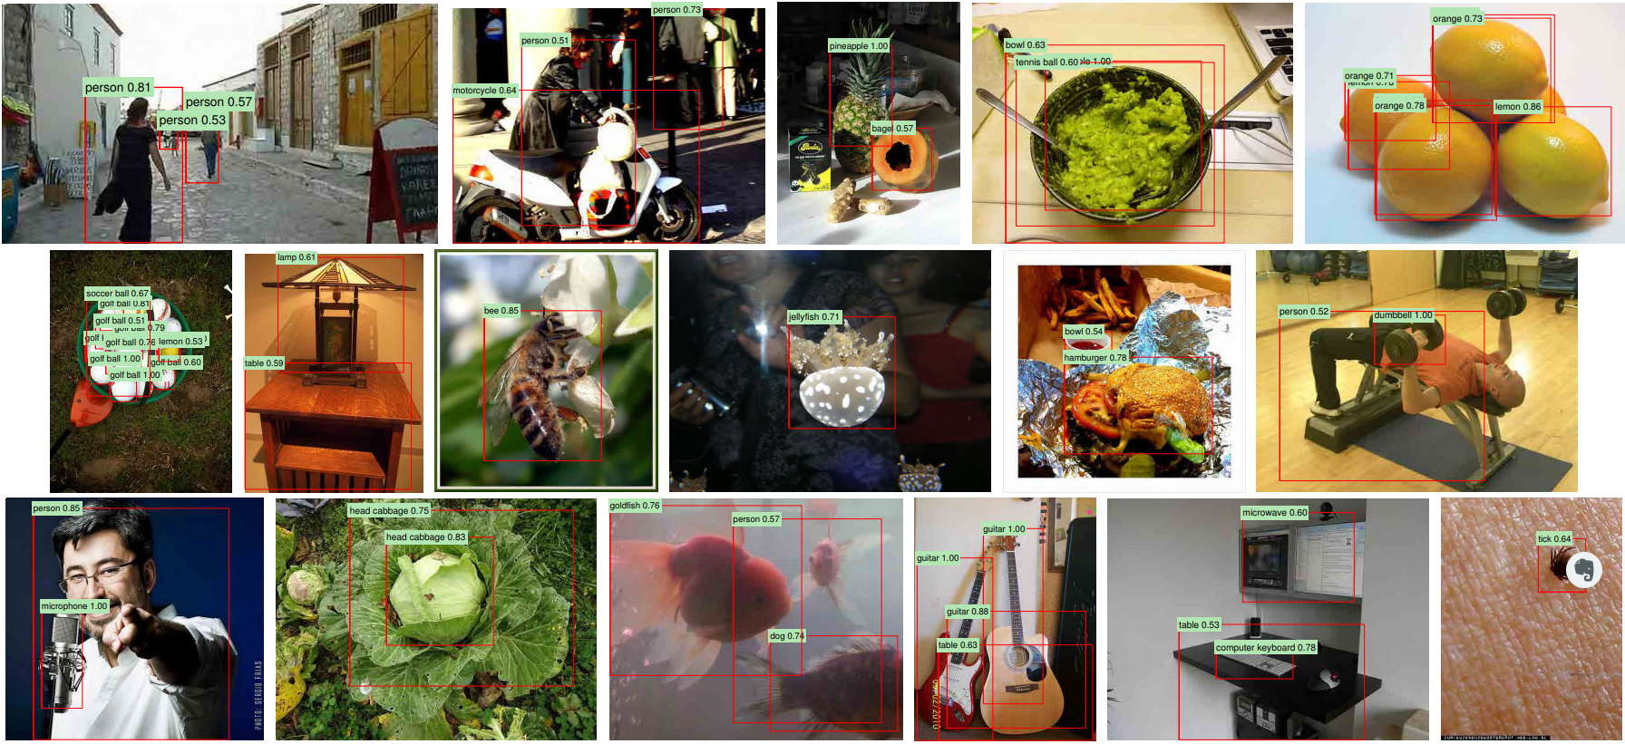
RCNN
Results

Slide 12
RCNN
Drawback
13s / image on a GPU
53s / image on a CPU

Slide 13
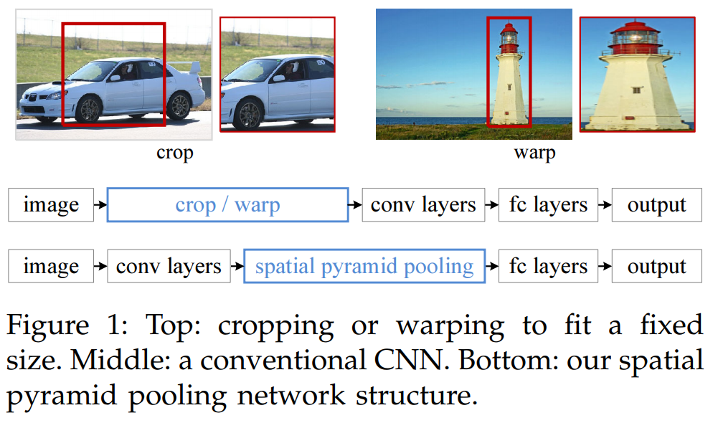
https://arxiv.org/pdf/1406.4729.pdf
2. Spatial Pyramid Pooling (SPPNet)
Only one CNN forward running

Slide 14
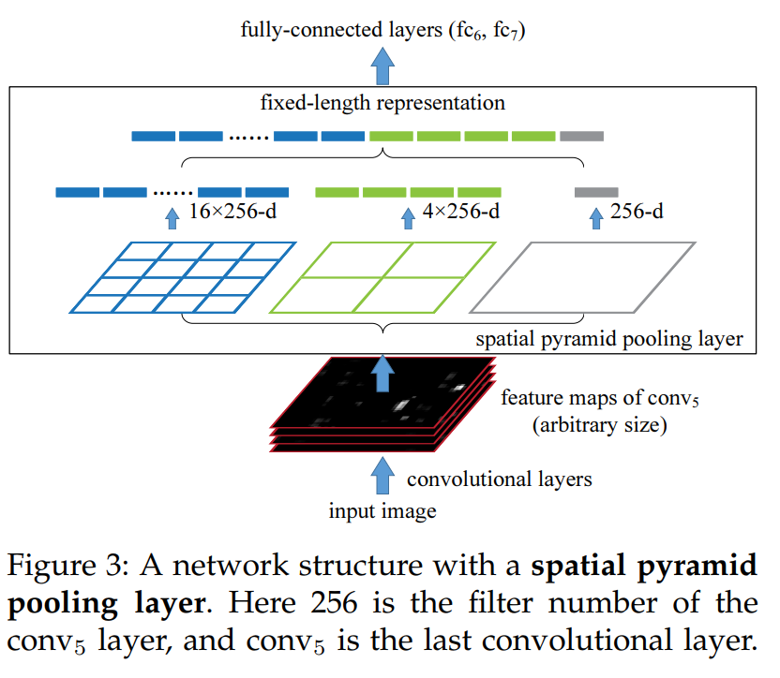
2. Spatial Pyramid Pooling (SPPNet)
Spatial pyramid pooling
Arbitrary size to fixed size
Bounding box: extracted from input image

Slide 15
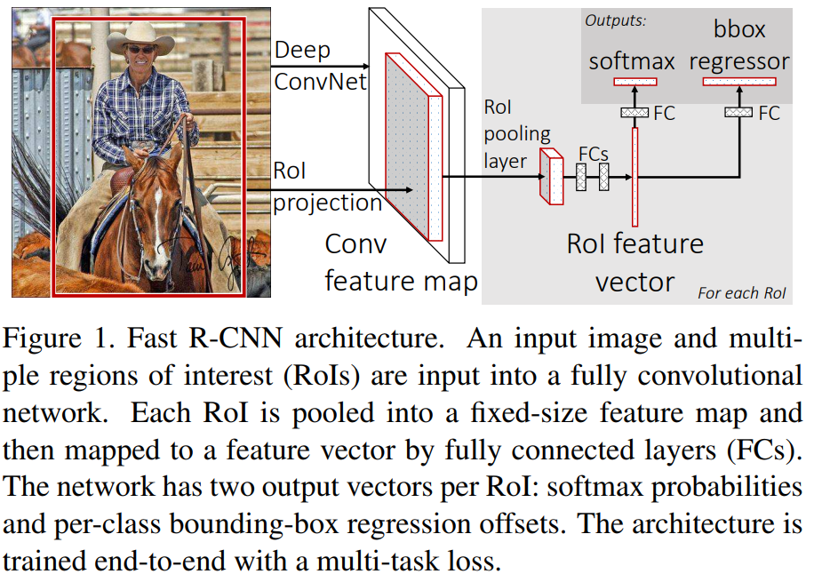
https://www.cv-foundation.org/openaccess/content_iccv_2015/papers/Girshick_Fast_R-CNN_ICCV_2015_paper.pdf
3. Fast R-CNN
Single stage training

Slide 16
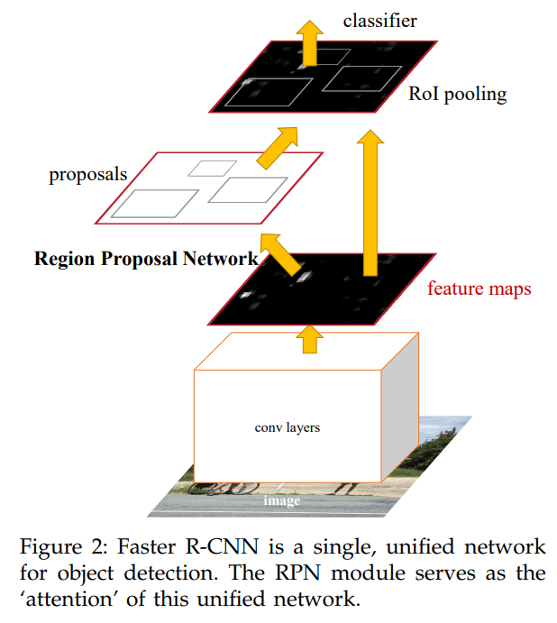
https://arxiv.org/pdf/1506.01497.pdf
4. Faster R-CNN
Region proposed net + Fast R-CNN

Slide 17
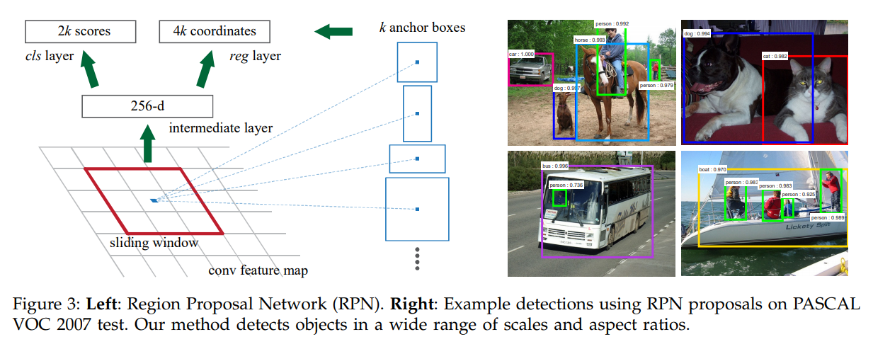
https://arxiv.org/pdf/1506.01497.pdf
4. Faster R-CNN
Region proposal net + Fast R-CNN

Slide 18

https://pjreddie.com/media/files/papers/yolo.pdf
5. You Only Look Once (YOLO)
Baseline: 45 fps
Smaller version: 155 fps

Slide 19
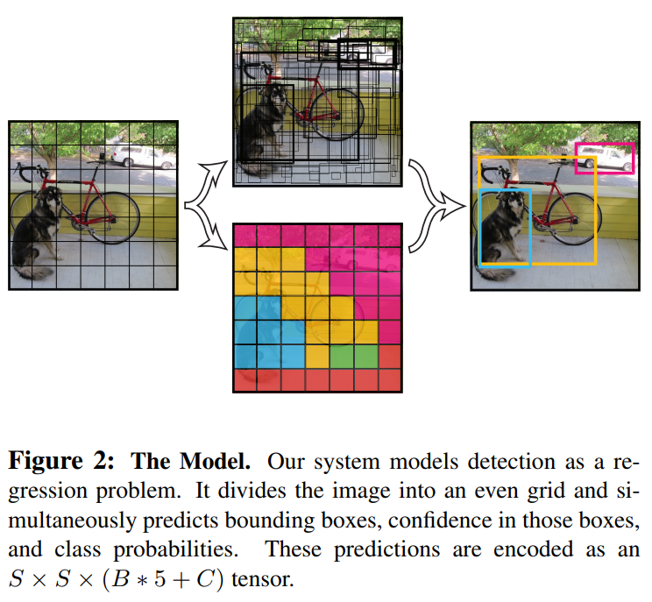
5. You Only Look Once (YOLO)
Baseline: 45 fps
Smaller version: 155 fps
Classify only one class per one grid
Conv feature map
Bbox + confidence = 5
C: classes

Slide 20
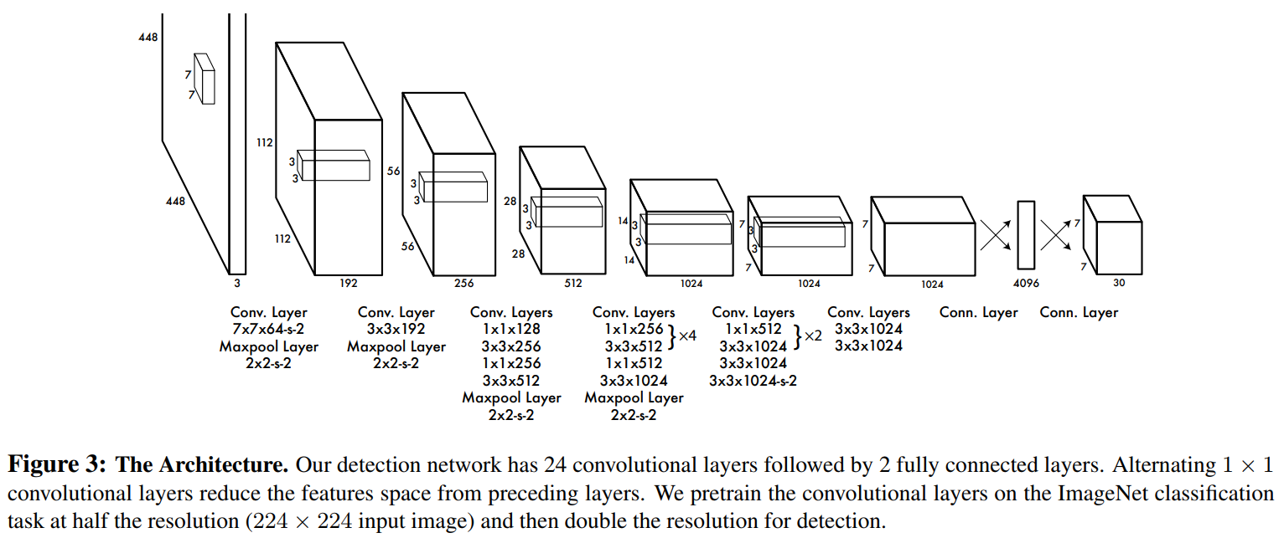
5. You Only Look Once (YOLO)
S: 7
B: 2
C: 20

